Slide 1
SI360 2024-Project
基于LiDAR传感器数据实现的SLAM算法
小组成员：佘成应 王奔

Slide 2
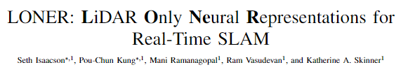
Baseline
Paper Address：https://arxiv.org/pdf/2309.04937v3
Github：https://github.com/umautobots/LONER
*Note: The open source code is written in Python and deployed using Docker. It needs to be modified and ported to the ROS2 platform by oneself
Isaacson S, Kung P C, Ramanagopal M, et al. Loner: Lidar only neural representations for real-time slam[J]. IEEE Robotics and Automation Letters, 2023.

Slide 3
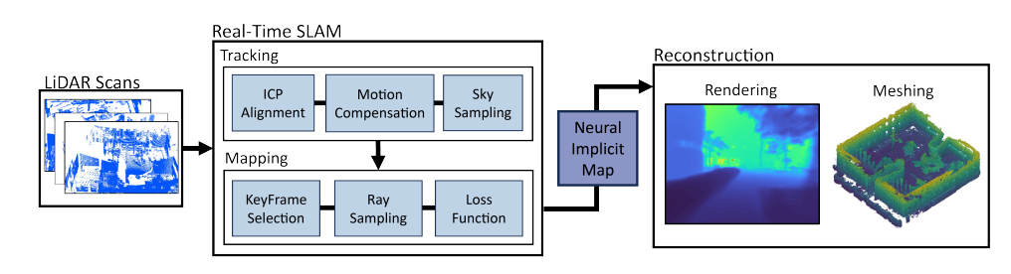
Overview of LONER
Technical Solution
First real-time LiDAR SLAM algorithm to use neural implicit scene representation. LONER uses LiDAR data to train MLP for real-time estimation of dense maps, while also estimating sensor trajectories.
This article proposes a new information theory loss function that takes into account the fact that different regions of the map may be learned to varying degrees throughout the entire online training process.

Slide 4
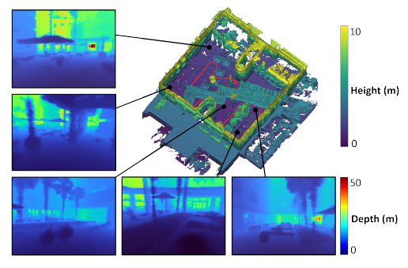
Overview of LONER
Results
Let's first take a look at LONER's mapping effect:The upper right corner is a Mesh map, with red representing trajectories, and other images being depth maps synthesized from new viewpoints. After training NeRF, LONER can render NeRF maps offline as Mesh and depth maps.

Slide 5
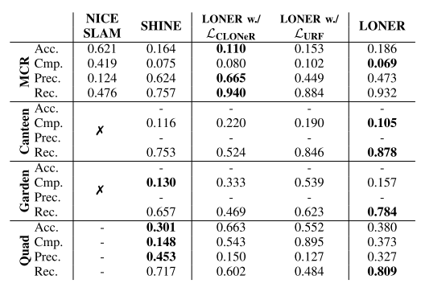
Overview of LONER
Evalutaion Results of LONER
Quantitative evaluation of map reconstruction performance

Slide 6
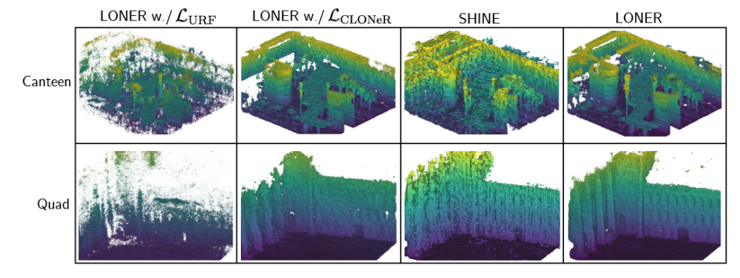
Overview of LONER
Evalutaion Results of LONER
Qualitative evaluation of mapping

Slide 7
Literature Review
VPE-SLAM：2024 IEEE International Conference on Robotics and Automation (ICRA)
Advantages：High-precision. This paper proposes a new method to generate high-quality reconstruction results for indoor scenes, which addresses the issue of geometric distortion in NeRF during scene reconstruction
Reference: Apply the method in the current paper to improve the NeRF point cloud reconstruction method in LONER and enhance the accuracy of outdoor scene reconstruction; Applying Voxelization Voxelization to Reduce Computational Complexity
Link: https://ieeexplore.ieee.org/document/10610865/
Github:[https://github.com/NeuCV-IRMI/VPE-SLAM]（Not open sourced）

Slide 8
Literature Review
Degenrate Detection：2024 IEEE International Conference on Robotics and Automation (ICRA)
Advantages：High precision and good robustness. Can provide better reconstruction results in special scenarios such as corridors and tunnels
Reference:Apply the local geometric model proposed in the paper to LONER and test the actual accuracy improvement
Link:https://ieeexplore.ieee.org/document/10610340/
Github:https://github.com/jisehua/Degenerate-Detection(Available)

Slide 9
Literature Review
FAST-LIO2：IEEE Transactions on Robotics
Advantages：Fast speed. In the case of a large amount of LiDAR data, FAST-LIO2 can quickly complete SLAM without waiting for all LiDAR data to be received, thus saving time.
Reference:Applying the ikd Tree proposed in the paper to optimize the SLAM front-end algorithm in LONER and accelerate processing speed
Link:https://ieeexplore.ieee.org/document/9697912
Github:https://github.com/hku-mars/FAST_LIO(Available)

Slide 10
Our target
VPE-SLAM
FAST-LIO2
Degenerate Detection

